Slide 1

Class #01: AI & the Intelligent Agent Concept
Artificial Intelligence (CS 131)

Slide 2
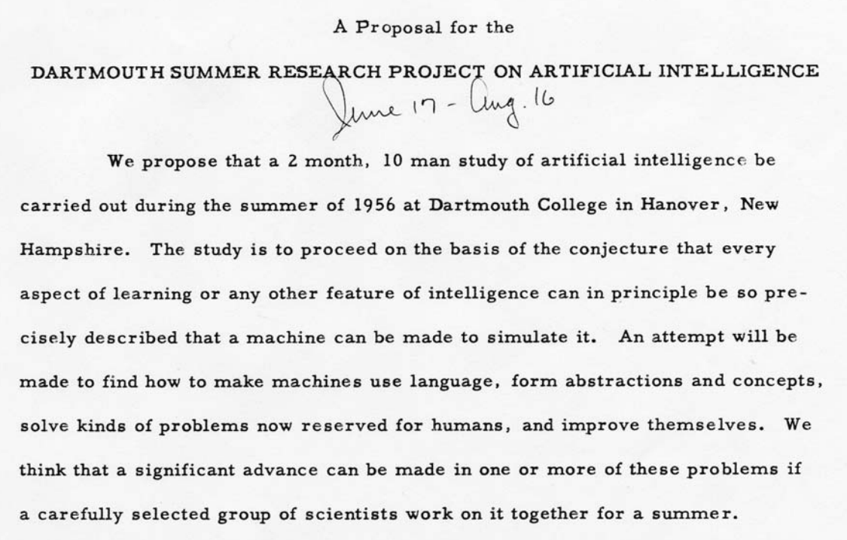
What is Artificial Intelligence?
Image courtesy of Dartmouth College
Historical definition (Dartmouth Workshop on AI, 1956):

Slide 3
Modern AI: An Engineering Enterprise
Building (partially) autonomous machines for a variety of tasks
Construction, transportation, search-and-rescue, exploration…
Automating intelligence and formalizing knowledge
Internet search, expert systems, data mining, …
Using computational models to understand complex behavior
Automated planning, large-scale crowd simulation, traffic analysis, …
Using computers to discover new information
Medical image analysis, intrusion detection, stock market trading, …
Allowing computers to work better with people
Reactive tutoring, automated assistants, “sensitive” GPS systems, …

Slide 4
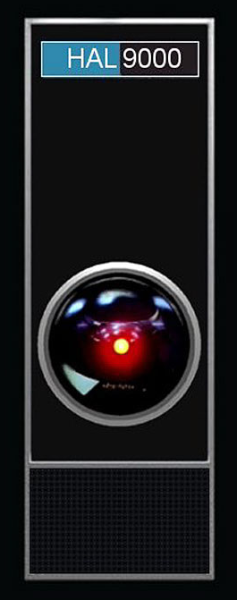
Why is AI So Difficult?
Originally, the desire was for a single system that would be “fully intelligent” on some human-approximate level
It turns out, however, that many of the basic capacities that go into “being human” are themselves very difficult
Highly complex
Involving various distinct capacities
Not well understood how we actually do them!

Slide 5
Sources of Difficulty for AI Developers
Ambiguity in language
“When the hammer hit the nail it bent.”
Computational difficulties
“Is there a winning opening move in a chess game?”
Reasoning under uncertainty
“What is the best strategy for a baseball game?”
Trade-offs between goals and outcomes
“Filter my spam, but not my requested commercial mail.”

Slide 6
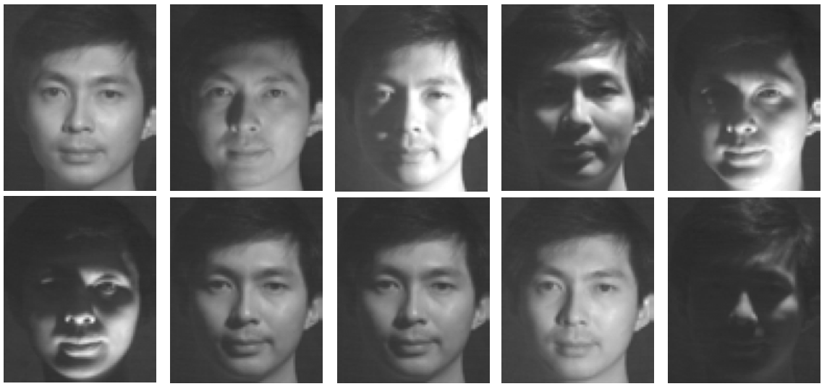
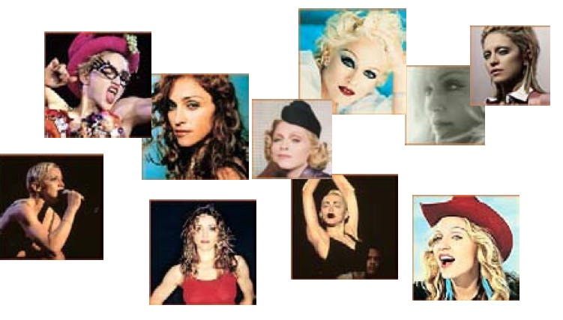

Slide 7
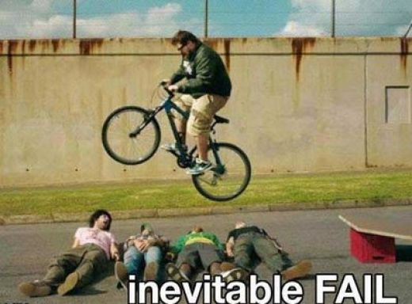
How Do We Define Intelligence?
It is not clear how “intelligence” should be understood (let alone how to get a machine to behave that way)
How a human being might act?
Or is it some sort of ideal rationality?

Slide 8
Turing Test: Intelligence = Acting Humanly
Alan Turing (1950) “Computing Machinery and Intelligence”
Proposed an imitation game
Predicted that by 2000, machines could fool average person for 5 minutes, 30% of the time
One problem: not everyone agrees on the standard proposed by the test, and whether it is meaningful
In any case, we still haven’t got there yet…
Loebner prize for convincing bots would award up to $100,000 (and a gold medal) for a truly convincing interactive agent
No such agent has ever really been approached

Slide 9
What Should an Intelligent System Do?
Following Turing, we take an operational approach:
An intelligent system is one that optimizes some measure
How much it changes things so that it gets closer towards the goals that have been set for it
The word-count of error-free text translated
Customer satisfaction for automated dialogue systems
Hours of accident free, real-time driving
Amount of data collected by an autonomous space-vehicle
…
Intelligence is defined by some means of measuring performance in a set task.

